Slide 3
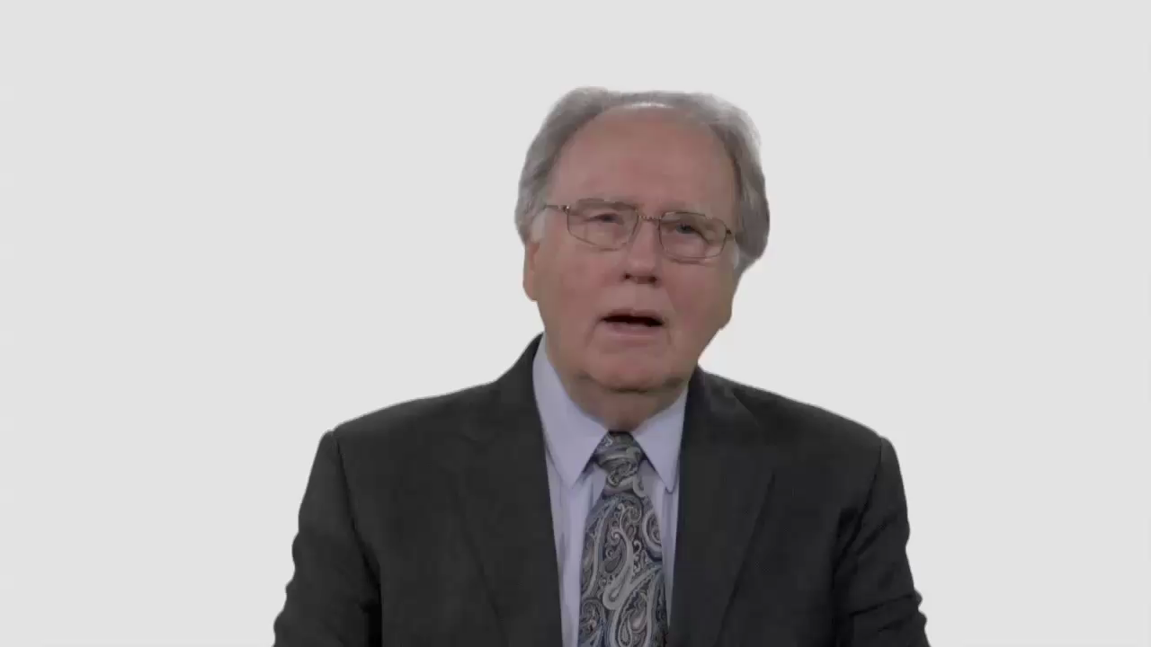

Slide 4
Have Your Say.
Have you ever gained the impression from others that some topics and questions are out-of-bounds for Seventh-day Adventists?

Slide 5
Conversation Builders.
What are some safeguards
that can help protect our faith as
we wrestle with difficult issues?

Slide 6
Conversation Builders.
Ellen White wrote: “It is God’s purpose that the kingly power of sanctified reason, controlled by divine grace, shall bear sway in the lives of human beings.” What do you think Mrs. White means by “sanctified reason”?

Slide 7
Discussion Questions.
Is the response “You must have
more faith!” ever a good answer
to young people who are
struggling with doubt?

Slide 8
Discussion Questions.
How do we affirm the vital role
of faith in the life of a believer,
without being dismissive of
those who have questions?

Slide 9
Discussion Questions.
Are there situations when it’s
not OK to ask questions—when
it’s more responsible to keep our intellectual struggles private?

Slide 10
Discussion Questions.
If being intellectually “adventurous” brings some risk to your spiritual
life, are there also dangers in
being intellectually “passive”?

Slide 11
What Now?
What practical steps could you
take to help make your local
Adventist church or school a
safe haven for young people?

Slide 12
What Now?
Are there specific safeguards
you’ll also need to put in place for
the good of the faith community?

